Slide 1
Strictly Manual Production
Transformable Production
Future
Flexibility, Production Variety
Fully Automated Production
Today
Volume, Degree of Automation

Slide 2
ROS Master
Registration Information
Registration Information
Node A
Message Topic
Node A
Publisher
Subscriber
Server
Client
Request
Service Topic
Reply

Slide 3
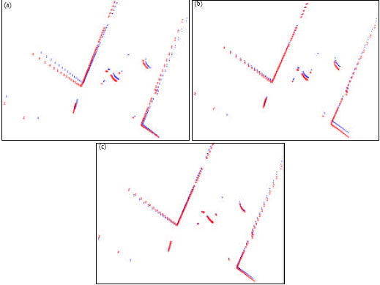
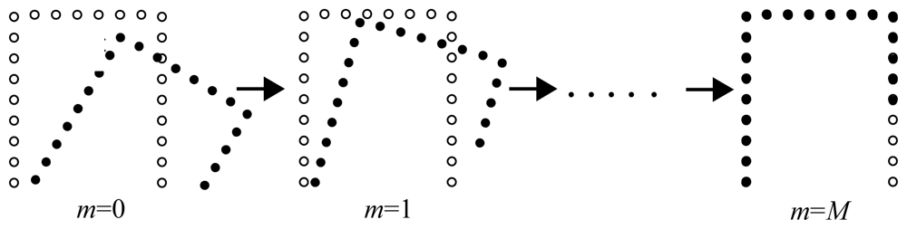

Slide 4
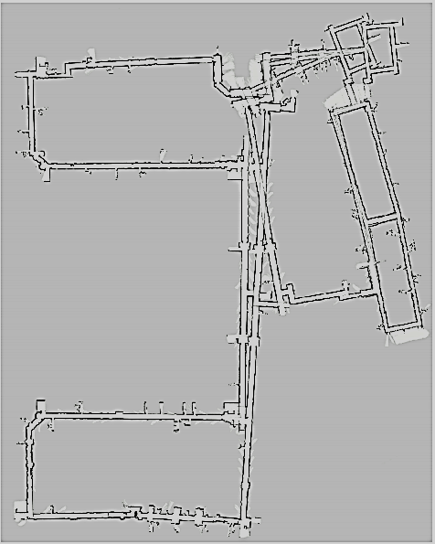
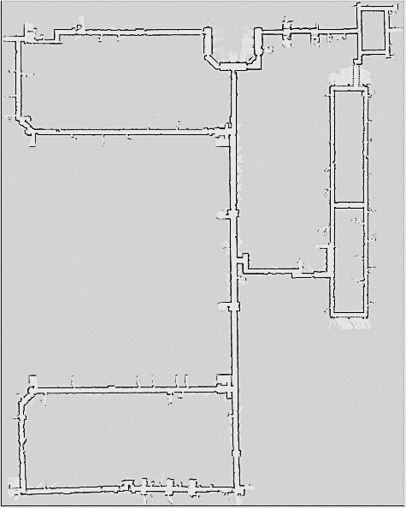
Optimized State
Front-End
Back-End
Sensor Messages
Optimized Map
Estimation Parameters
Feature Extraction
Map Generation
State Variables
Odometry
Scan Matching
Map Optimization

Slide 5
Yellow
White
255, 255, 0
255, 255, 255
Green
Cyan
0, 255, 0
0, 255, 255
Red
Magenta
255, 0, 0
255, 0, 255
Black
Blue
RGB Color Space
HSV Color Space
0, 0, 0
0, 0, 255
Value
Yellow
White
Green
Yellow
255, 255, 0
255, 255, 255
120°
60°
Green
Cyan
White
Red
Cyan
1.0
180°
0°
0, 255, 0
0, 255, 255
Blue
Magenta
240°
300°
Red
255, 0, 0
255, 0, 255
Magenta
0, 0, 0
0, 0, 255
Hue
Black
Blue
Black
Saturation
0.0
1.0

Slide 6





Original
Erosion
Dilation
Opening (Erosion/Dilation)
Closing (Dilation/Erosion)

Slide 7
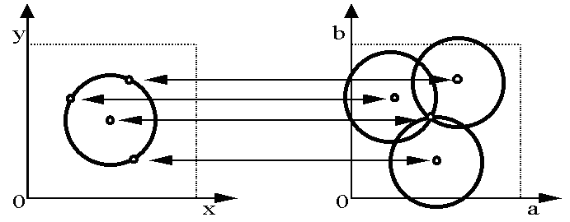
Intersection: most votes for center occur here.
y
b
0
x
0
Hough space
a
Image space
Image Space
Hough Space

Slide 8
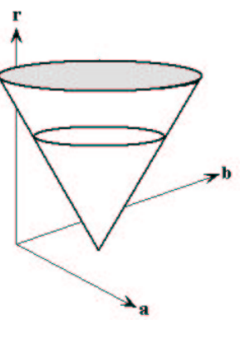
r
b
a

Slide 9
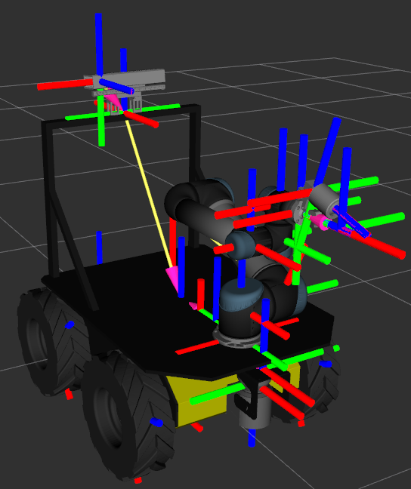
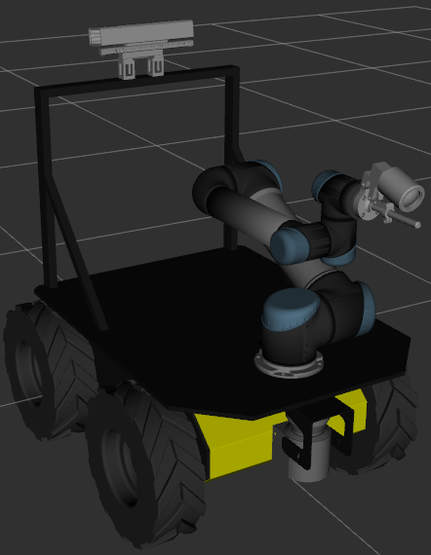
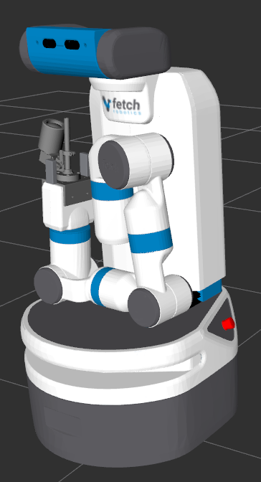
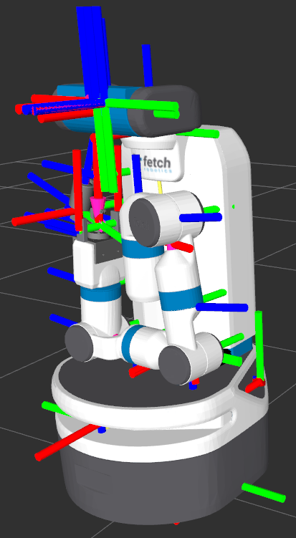

Slide 10
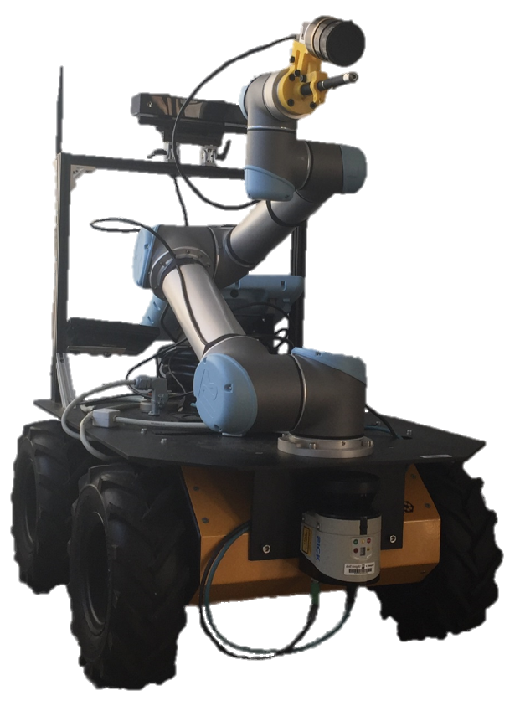
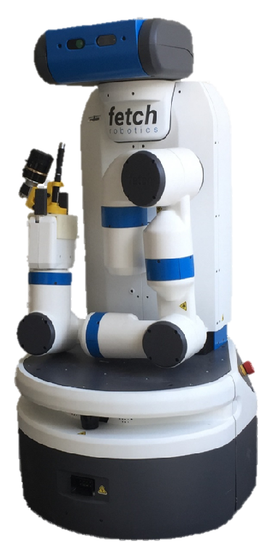
RGB-D Camera
RGB Camera
Laser Pointer
Manipulator
Lidar

Slide 11
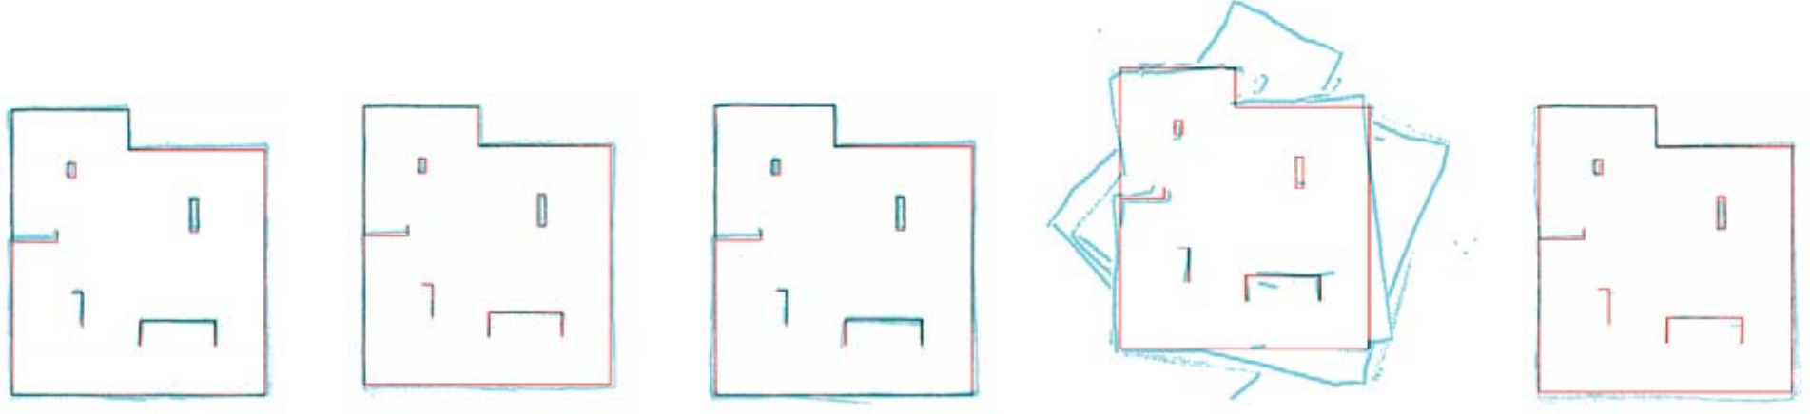
HectorSLAM
GMapping
KartoSLAM
CoreSLAM
LagoSLAM

Slide 12


